Slide 1
GIS 2019 Group Project SFO
Erica, Victoria, Serena

Slide 2
Introduction
Names: Serena Wee, Victoria Enciso, Erica Sailors
What our project is about?
Based on the different type of cancer found in women and the number cancer cases that were recorded.

Slide 3
Why we chose this project?
American Cancer Society surveyed the number of women who experience cancer of any kind. We chose this project to spread awareness of the biggest killer in women’s life. We want people to start taking care of themselves as the grow.

Slide 4
How We Did It
We used a computer program called Spyder that allows you to create a code with Python and test it
On this program we used the libraries pandas and plotly. Pandas allowed us to read data from a separate file and read it back to us in Spyder. We again use Pandas to create a data frame. Then we used Plotly to plot this data frame into a graph.

Slide 5
Code→
import pandas as pd
import plotly
import plotly.graph_objs as go
from plotly.offline import plot
df = pd.read_excel("GISdata.xlsx", sheet_name = "cancercases")
print(df)
cancercases = go.Bar(x=df["CancerType"], y=df["Number"],
marker = {"color": df["Number"], "colorscale" : "Portland"}
)
titles = go.Layout(
title = "Number of Cancer cases by types within women",
xaxis=go.layout.XAxis(
title=go.layout.xaxis.Title(
text="Types of Cancer",
)
),
yaxis=go.layout.YAxis(
title=go.layout.yaxis.Title(
text="Numbers of Cases",
)
)
)
fig = go.Figure(data=[cancercases], layout = titles)
plot(fig)
Language used: python

Slide 6
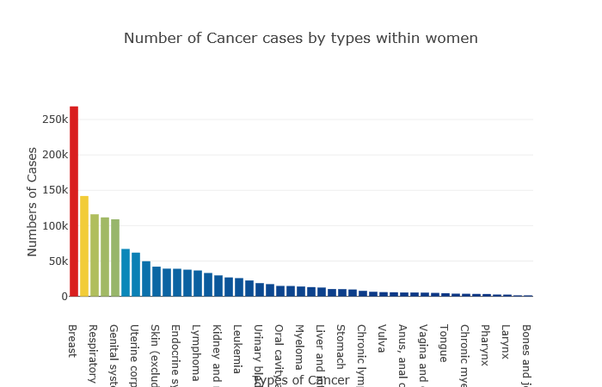

Slide 7
Conclusion
Observations:
The highest cancer in women is Breast Cancer
There are under 150,000 cases of any other cancer beside Breast
This highlights the lack of cancer screening knowledge and the data can help spread awareness of the different cancers in women.
The second highest cancer(Respiratory) has about 141 thousands cases, compared to Breast Cancer at about 270 thousand cases
Inferences:
That cancers like Bone, Joint, or Larynx cancers have low recognition.

